Slide 2
Dr gavidel journal club govaresh

Slide 3
liver cancers are the fourth most common cause of cancer-related death and rank sixth in terms of incident case
With a 5-year survival of 18%, liver cancer is the second most lethal tumor, after pancreatic cancer
mostly as a result of hepatitis B or C virus (HBV or HCV) infection or alcohol abuse

Slide 4
nonalcoholic fatty liver disease (NAFLD), which together with metabolic syndrome and obesity amplifies the risk of liver cancer, will soon become a leading cause of liver cancer in Western countries
Racial or ethnic group diftferences :
with blacks and Hispanics less likely than whites to undergo curative therapies

Slide 5
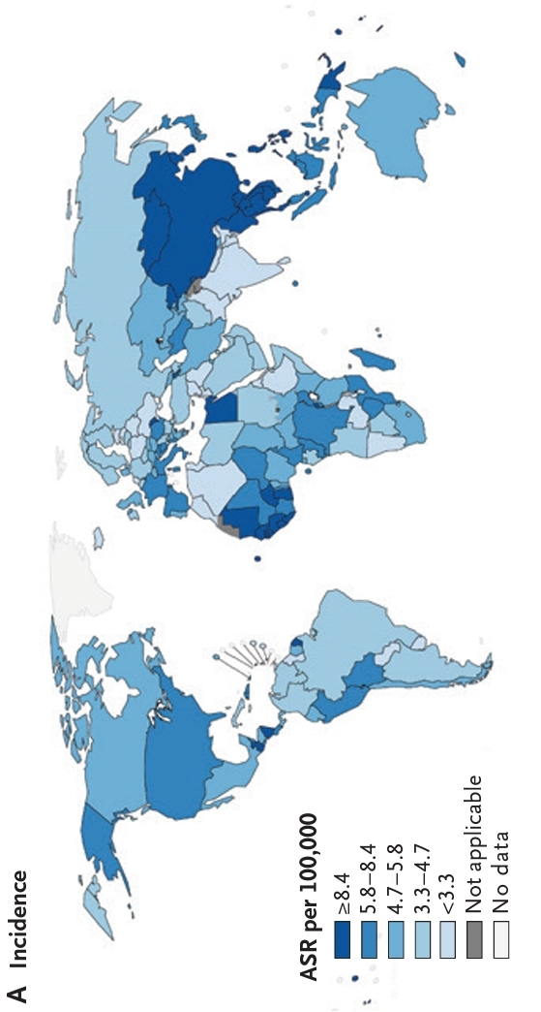

Slide 6
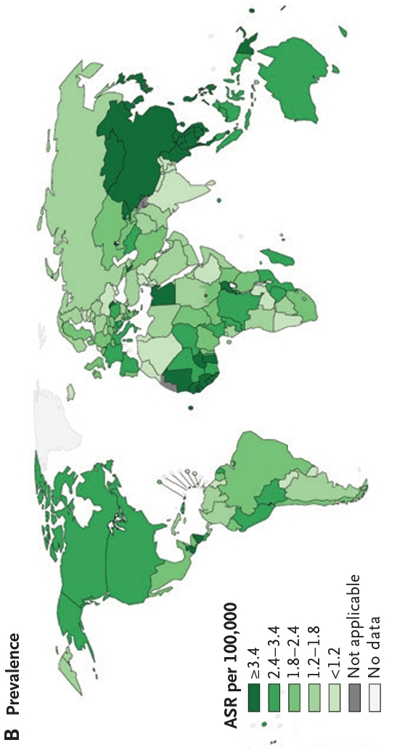

Slide 7
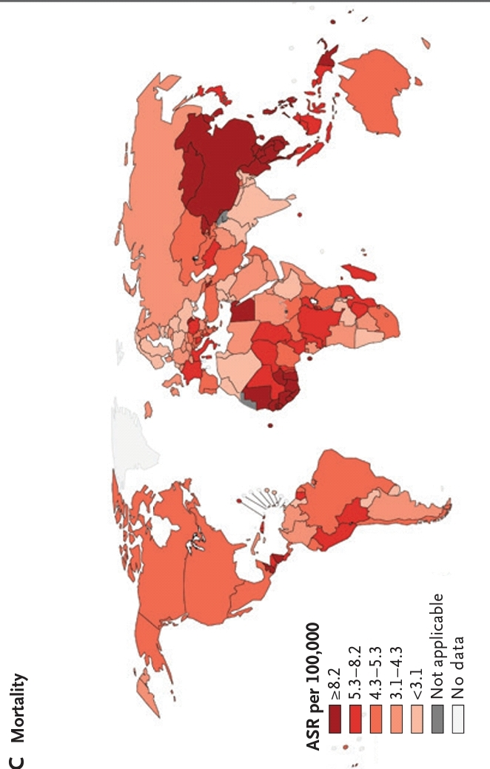

Slide 9
sustained hepatic inflammation
Fibrosis
aberrant hepatocyte regeneration
Cirrhosis
HCC
Dysplastic nodules

Slide 10
Hepatocellular carcinoma can also arise in patients who have chronic liver disease but do not have established cirrhosis or marked inflammation (e.g., patients with HBV infection).

Slide 11
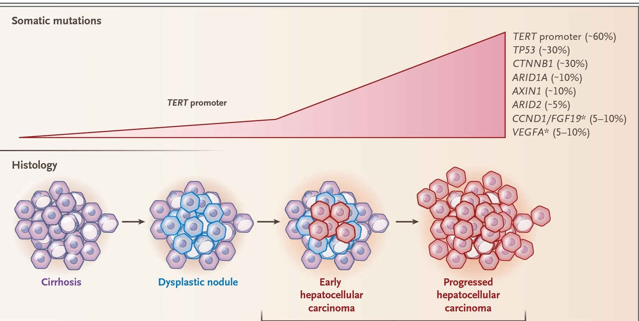

Slide 12
Patients with hepatocellular carcinoma at the same clinical stage can have different molecular subtypes
have not been thoroughly tested as predictors of a response to systemic therapies, which has limited their clinical usefulness

Slide 13
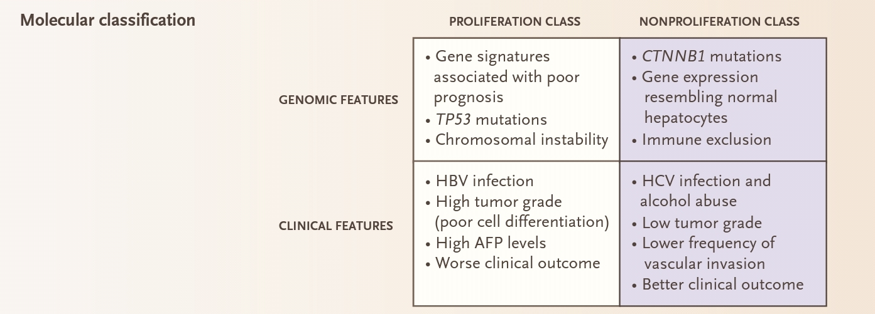

Slide 14
Hepatocellular carcinoma is among the solid cancers with the fewest somatic mutations that can be targeted with molecular therapies
no mutation is used in clinical practice to predict a therapeutic response.
High-level DNA amplifications located in chromosome 6p21 and 11q13, the respective loci for VEGFA and CCND1/FGF19, could also be targeted with molecular therapies, but their prevalence is low.

Slide 16
rare among patients without liver disease
twice as common in men as in women
Cirrhosis of any cause annual : incidence between 2 and 4%. This risk varies according to
cause,
geographic area,
sex,
age,
degree of liver damage

Slide 17
Worldwide, HBV infection is the main cause of hepatocellular carcinoma.
Dietary exposure to aflatoxin B1 amplifies the risk of hepatocellular carcinoma among patients with HBV infection, through a specific mutation in TP53 at position 249 (R→S)

Slide 18
In Western countries and Japan, the main cause of hepatocellular carcinoma is HCV infection
The incidence of hepatocellular carcinoma due to NAFLD is increasing worldwide
Alcoholic cirrhosis is another frequent cause of hepatocellular carcinoma.
Smoking and coinfection with the human immunodeficiency virus can also contribute to the development of hepatocellular carcinoma.

Slide 19
HBV infection has a direct oncogenic effect, regardless of the degree of underlying liver fibrosis
but hepatocellular carcinoma rarely occurs in HCV-infected patients who do not have advanced fibrosis

Slide 20
Antiviral therapies are effective in reducing the incidence of hepatocellular carcinoma but do not eradicate the risk
Apart from treatment of the cause of the liver disease, no drugs are known to reduce the incidence of hepatocellular carcinoma.

Slide 22
Patients with cirrhosis and advanced liver dysfunction, who would not be eligible for a curative treatment, are not candidates for surveillance.
This does not apply to candidates for liver transplantation as a result of liver dysfunction

Slide 23
The risk of hepatocellular carcinoma among patients with chronic HBV infection varies
across geographic regions (with higher risks in Africa and Asia than in other regions)
increases with age
male sex
presence of liver fibrosis
high level of viral replication
genotype C
family history of hepatocellular carcinoma.

Slide 24
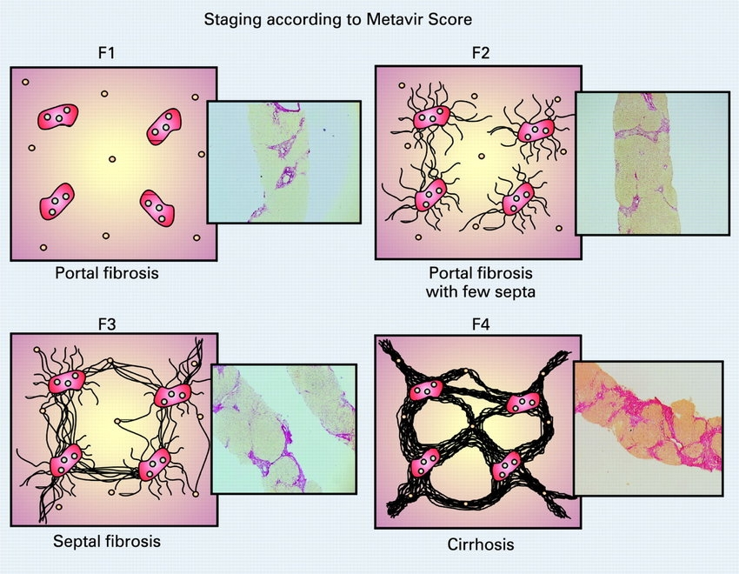
Patients with chronic HCV infection and advanced fibrosis, defined by the Mettavir system as a score of F3 or higher on a scale of F0 to F4, with higher scores indicating more severe fibrosis

Slide 25
Until there are methods available to identify patients who are at increased risk, surveillance is not recommended for patients who have NAFLD without cirrhosis

Slide 26
Abdominal ultrasonography every 6 months is the recommended method for surveillance
with or without measurement of serum levels of alpha-fetoprotein

Slide 28
because of the vascular shift that occurs during malignant transformation of hepatocytes, in which benign lesions (e.g., regenerative and dysplastic nodules) are supplied by branches of the portal system, whereas malignant nodules are supplied by blood from the hepatic artery.
This shift translates into a distinctive pattern of hyperenhancement in the arterial phase and washout in venous or delayed phases on contrast-enhanced CT or MRI. This pattern has a sensitivity between 66% and 82% and a specificity higher than 90% for the diagnosis of hepatocellular carcinoma in patients with cirrhosis and nodules larger than 1 cm in diameter.

Slide 29
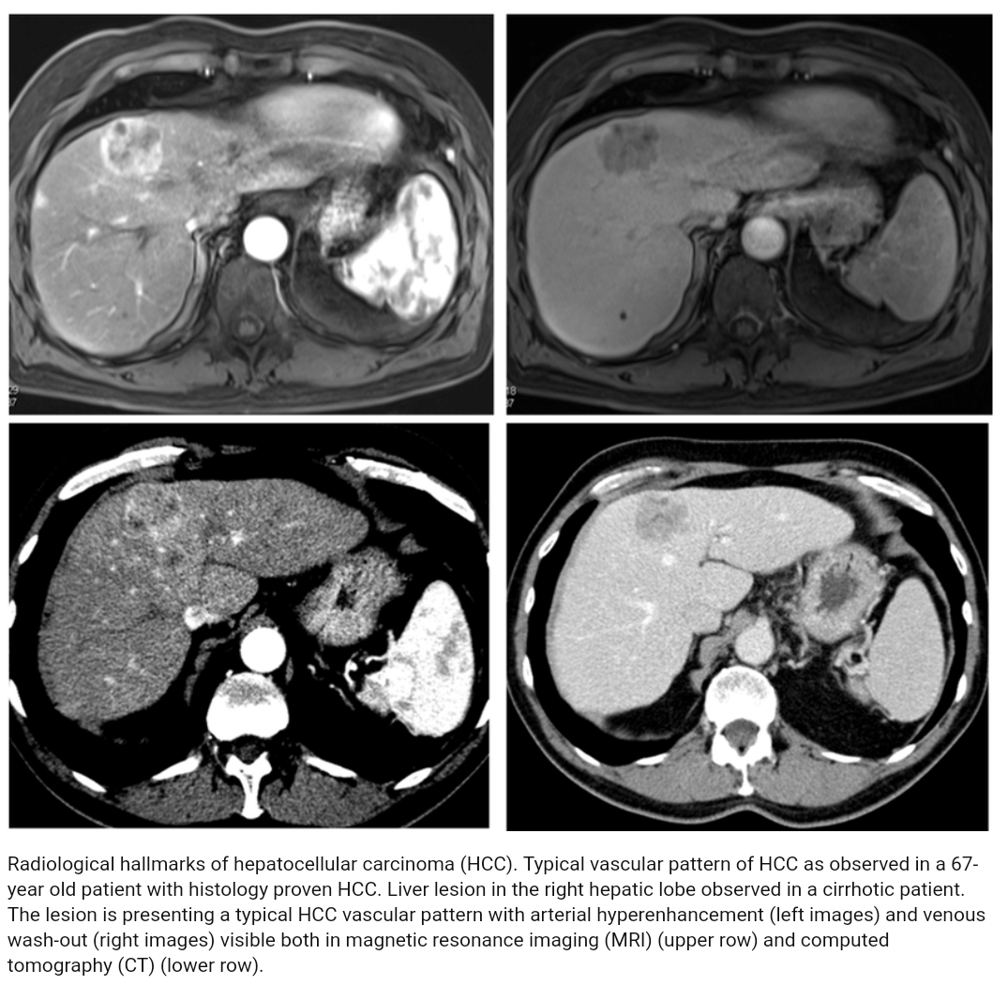

Slide 30
Establishing a histologic diagnosis in a patient with small nodules can be challenging, but a set of immunostaining m
glypigan 3
heat shock protein 70
glutamine synthetase — increase diagnostic accuracy.
Patients who have cirrhosis with nodules that are less than 1 cm in diameter should undergo ultrasound surveillance every 3 to 4 months and be considered for a return to conventional surveillance if the nodule is stable in size after 12 months

Slide 31
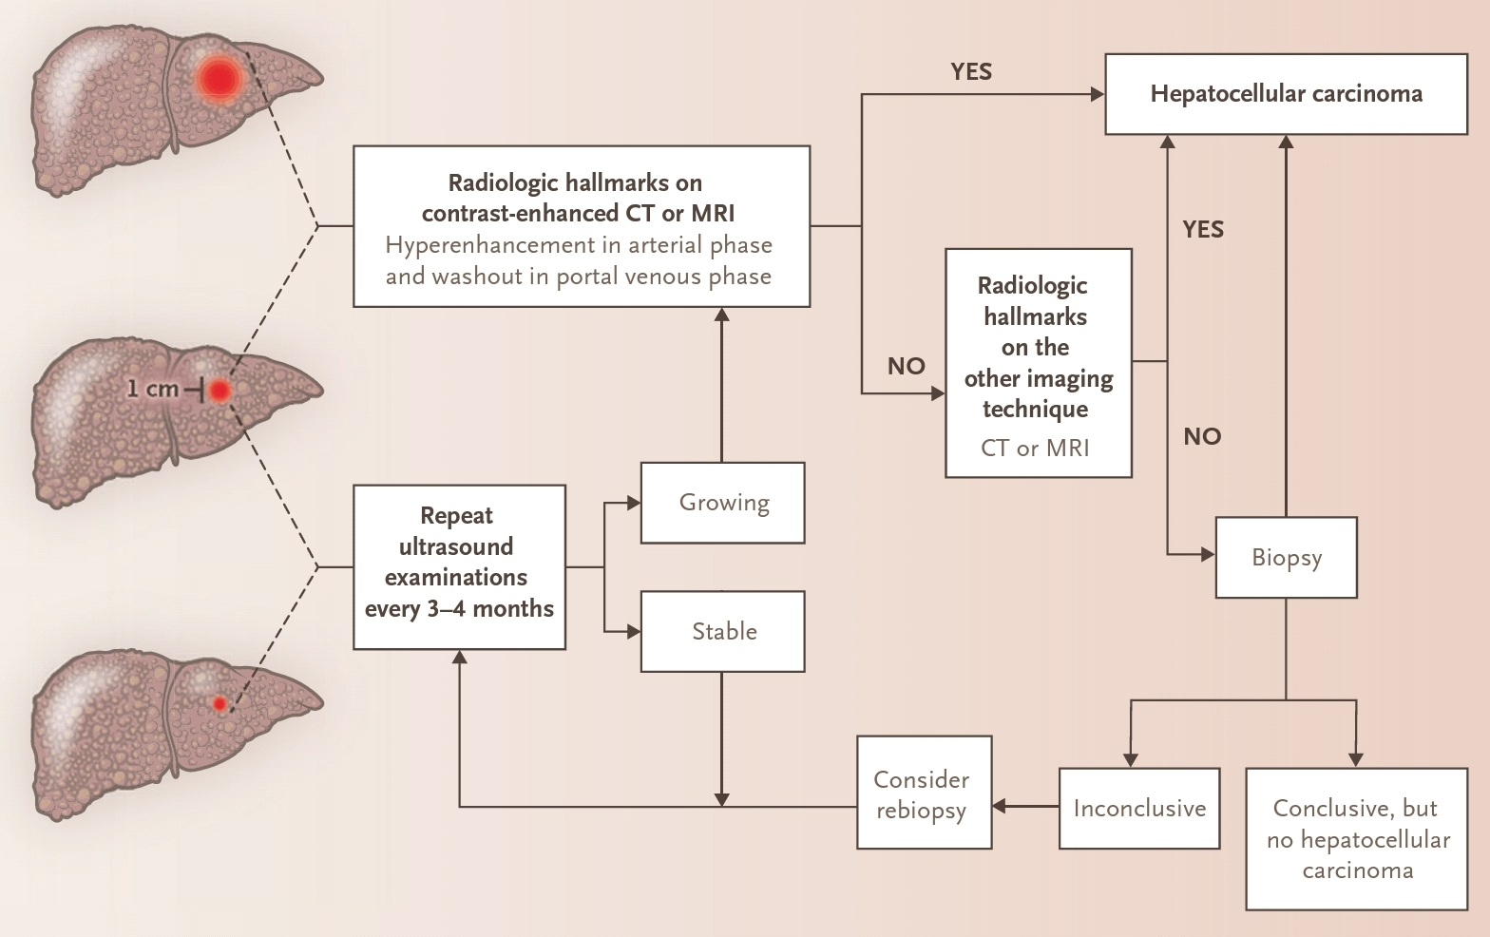

Slide 33
complexity in the management of hepatocellular carcinoma calls for a multidisciplinary approach, with ex-pertise in hepatology, hepatobiliary surgery, pa-thology, oncology, radiology (both diagnostic and interventional), and specialized nursing

Slide 35
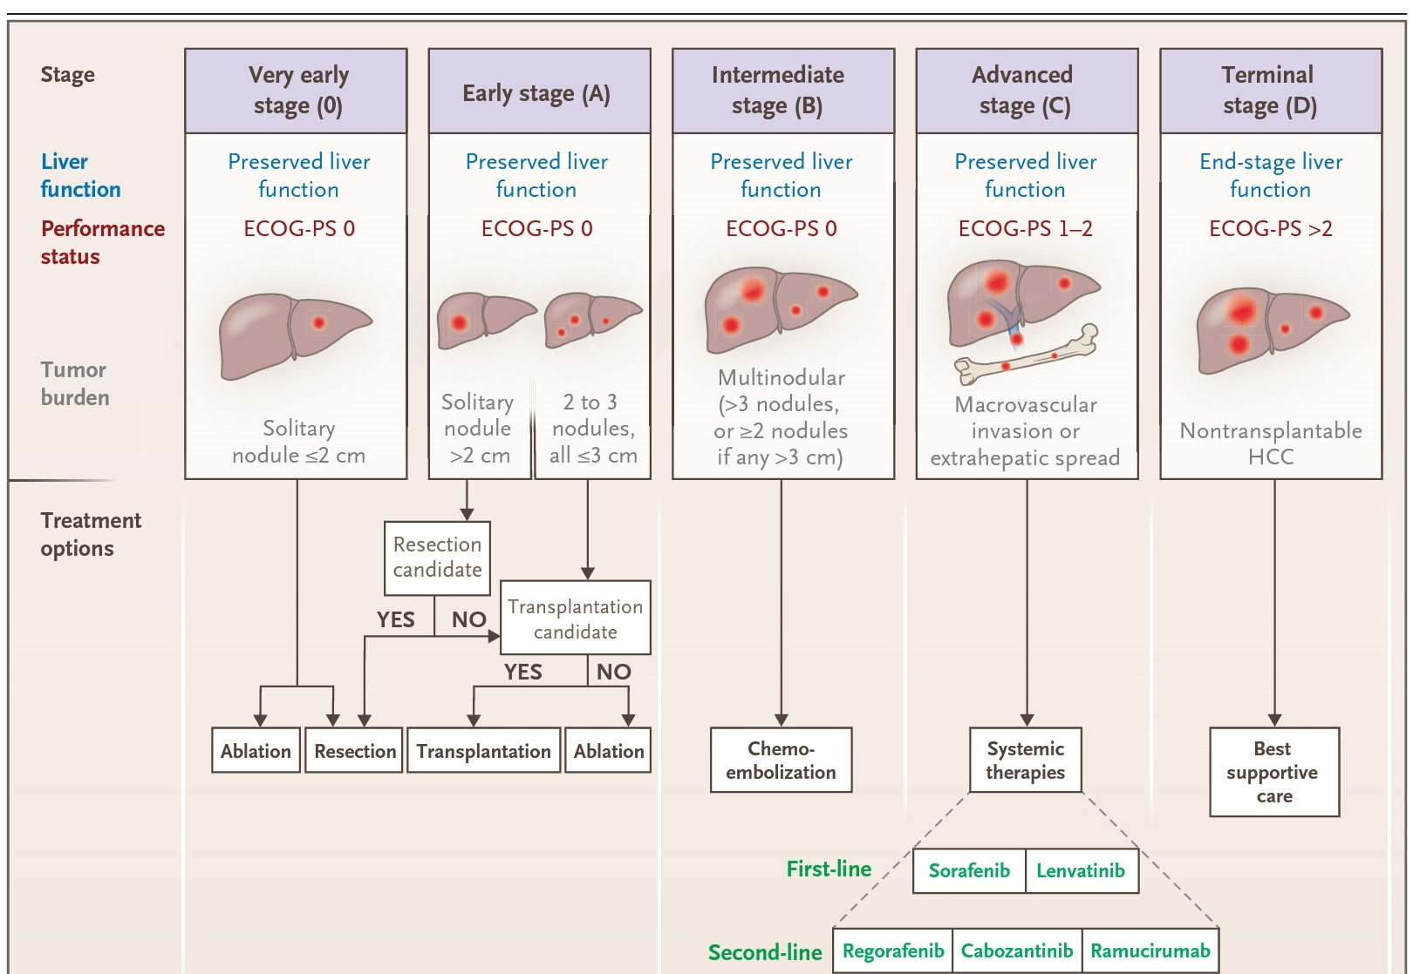

Slide 36
The ideal candidates for resection are
patients with a solitary tumor at an early stage (BCLC stage 0 or A) regardless of tumor size
in whom the performance status is good
liver function is well preserved
there is no clinically significant portal hypertension
survival above 60% at 5 years,

Slide 37
The main method is image-guided, percutaneous radiofrequency ablation, which achieves tumor necrosis by inducing a high intratumoral temperature.
The extent of tumor necrosis is negatively correlated with tumor size and drops significantly in tumors larger than 3 cm in diameter
Other ablative options include
microwave ablation
Cryoablation
ethanol injection

Slide 38
intermediate-stage tumors (BCLC stage B) should be considered for transarterial therapies
TACE should not be considered in patients with decompensated cirrhosis.
use of drug-eluting beads has antitumoral activity similar to that of conventional TACE, with fewer side effects, whereas the use of bland embolization is more controversial
Median survival with TACE ranges from 26 to 40 months, depending on patient selection

Slide 39
Selective internal radiation therapy (SIRT)
in patients with BCLC stage B tumors
based on the intraarterial infusion of microspheres with the radioisotope yttrium-90.
Unlike TACE, SIRT does not include a macroembolic step.
No randomized phase 3 trials have compared TACE and SIRT with respect to survival, but numerous cohort and retrospective studies indicate that SIRT is a safe procedure with an objective response similar to that seen with TACE

Slide 40
Sorafenib was the first systemic drug approved by (FDA) for the treatment of hepatocellular carcinoma and is the standard of care for frontline therapy
Lenvatinib, another inhibitor of multiple kinases, showed antitumoral activity in a noninferiority trial.
Median survival was 13.6 months with lenvatinib and 12.3 months with sorafenib.
adverse events with lenvatinib included hyperrtension, decreased weight palmar–plantar erythrodysesthesia Lenvatinib received FDA approval in 2018.

Slide 41
Regorafenib, also an inhibitor of multiple kinases, increased survival, as compared with placebo, from 7.8 to 10.6 months among patients with tumor progression during treatment with sorafenib.
With a safety profile similar to that of sorafenib, regorafenib decreased the risk of death by 37%, as compared with placebo, and became the first drug approved by the FDA for second-line treatment.

Slide 42
Cabozantinib, an inhibitor of receptor tyrosine kinases, including VEGFR, MET, and AXL, reduced the risk of death, as compared with placebo
Ramucirumab, an antibody against VEGF receptor 2 improved survival, as compared with placebo

Slide 44
Impact of coffee on HCC development
Numerous epidemiological studies have addressed the prevention of HCC in patients with chronic liver disease
Trials analyzing the effect of coffee consumption have shown a consistently positive effect with regard to lowering HCC incidence
Recommendations
Coffee consumption has been shown to decrease the risk of HCC in patients with chronic liver disease In these patients, coffee consumption should be encouraged | Moderate | Strong
Level of evidence
Grade of recommendation
EASL CPG HCC. J Hepatol 2018; doi: 10.1016/j.jhep.2018.03.019
Notes:
HCC, hepatocellular carcinoma

Slide 48
Algorithm for diagnosis and recall in cirrhotic liver
Mass/nodule at imaging
<1 cm
>1 cm
Repeat US at 4 months
Multiphasic contrast-enhanced CT or MRI,*
or gadoxetic-enhanced MRI†
Stable‡
Growing/changing pattern
1 positive technique: HCC imaging hallmarks
No
Yes
‖
Biopsy unclear:
Consider re-biopsy
Use other modality: multiphasic contrast-enhanced CT or MRI,* or gadoxetic-enhanced MRI,† or contrast-enhanced ultrasound§
1 positive technique: HCC imaging hallmarks
Non-HCC malignancy/
benign
No
Yes
Biopsy
HCC
*Using extracellular MRI contrast agents or gadobenate dimeglumine; †Diagnostic criteria: APHE and washout on the portal venous phase; ‡Lesion <1 cm stable for 12 months (three controls after 4 months) can be shifted back to regular 6-month surveillance; §Diagnostic criteria: APHE and mild washout after 60 seconds; ‖Optional for centre-based programmes
EASL CPG HCC. J Hepatol 2018; doi: 10.1016/j.jhep.2018.03.019
Notes:
APHE, arterial phase hyperenhancement, CT, computed tomography; HCC, hepatocellular carcinoma; MRI, magnetic resonance imaging; US, ultrasound

