Slide 1
Approach to cytomegalovirus infections in patients with ulcerative colitis

Slide 2
Dr gavidel journal club govaresh

Slide 3
Introduction
Cytomegalovirus (CMV) is a double-stranded DNA virus of the family Herpesviridae.
Humans are the only natural hosts of CMV, and infections are common; the seroprevalence ranges from 45% to 100%.
CMV lesions may be caused by primary infection or reactivation of latent virus, or may develop when a seropositive patient is reinfected via transplantation or blood transfusion.

Slide 4
CMV reactivation in patients of compromised immune status (such as organ transplant recipients or those with acquired immunodeficiency syndrome [AIDS]), can cause severe complications, including pneumonia, retinitis, and colitis.
CMV lesions are evident throughout the gastrointestinal tract; thus, from the oral cavity to the rectum. However, colon involvement is most commonly reported
In UC patients, mucosal inflammation often becomes exacerbated and immunomodulatory steroids are commonly given to treat such flare-ups. Such treatment may induce CMV colitis. However, any role for CMV in exacerbation of inflammatory bowel disease (IBD) remains unclear.
Furthermore, the treatment of patients with both a CMV infection and UC remains very controversial.

Slide 5
THE ROLE PLAYED BY CMV INFECTION IN IBD
The prevalence of CMV infection in patients with moderate-to-severe UC ranged from 16% to 34% when various diagnostic methods (serological and histological tests) were employed .
The CMV infection rate in those with severely steroid-refractory UC ranged from 20% to 40% when infection was diagnosed using a combination of antigenemia and histological evaluations.
Recently, a multicenter, prospective Korean study detected CMV infections in 43% and 67% of patients with moderate-to-severe active and steroid-refractory UC, respectively, based on both serological testing (immunoglobulin M [IgM] antibody levels) and histological criteria including IHC staining and polymerase chain reaction (PCR).
UC patients become CMV-infected at a markedly higher rate than do Crohn disease (CD) patients . Most CD patients are negative for CMV upon IHC staining, and CMV was very rarely detected (< 5% of patients) via PCR of biopsy and fecal specimens .

Slide 6
CD is an inflammatory disease involving; T helper (Th) 1 and Th17 cells with high expression of the antiviral cytokine IFN-γ.
UC is a Th2-type inflammatory process with downregulation of these cytokines.
Carrying CMV does not necessarily imply that CMV-mediated disease is present.
CMV infection implies that CMV is detectable in blood or biopsy specimens either serologically or via viral DNA analysis; CMV disease includes only conditions characterized by clinical symptoms and end-organ damage attributable to the virus.
Features such as:
fever,
leukopenia,
hemaphagocytosis,
meningoencephalitis,
pneumonitis,
colitis, and
hepatitis.

Slide 7
Recent studies have suggested that CMV may exacerbate the course of UC. CMV infection increased the risk of hospitalization attributable to UC exacerbation 8.2-fold, and patients with histories of CMV colitis within the 3 months prior to commencement of infliximab therapy were 6.47-fold more likely not to respond to such therapy
However, another study found that CMV reactivation in patients with moderate-to-severe UC did not significantly affect the proportions of patients entering remission or requiring colectomies However, in the cited study, the CMV reactivation group contained a significantly higher proportion of patients who underwent early rescue therapy using cyclosporine .
Therefore, CMV infection may be poorly prognostic of the course of UC.

Slide 8
DIAGNOSIS OF CMV COLITIS
When should UC complicated by CMV infection be suspected?
When should UC complicated by CMV infection be suspected?
Although patients with UC may require early diagnosis and appropriate treatment of CMV infection, CMV may become sporadically reactivated in such patients and then disappear even without prescription of antiviral agents.
Found that it was rare (< 5% of cases) for patients with IBD to develop an active CMV infection (CMV IgM-positivity or CMV DNA detected via qualitative or quantitative PCR in peripheral blood or a fecal specimen).

Slide 9
Therefore, blood tests exploring CMV infection status need not be performed in all IBD patients.
Reported risk factors for CMV disease in IBD patients include:
Age > 30 years,
Immunomodulatory treatment,
Refractoriness to drugs such as corticosteroids or TNF antagonists
leukocyte count < 11,000/mL
a disease duration < 60 months ,
Thus, CMV infection status should be determined in older UC patients who are refractory to immunomodulators such as high-dose steroids, or whose symptoms persist or deteriorat

Slide 10
Symptoms and signs of CMV colitis
However, it is difficult to distinguish UC exacerbation from CMV colitis by reference to symptoms only. CMV colitis may be accompanied by diarrhea, bloody stool, crampy abdominal pain, rectal urgency, and tenesmus, as well as systemic conditions such as fever, fatigue, and weight loss. C-reactive protein levels increase abruptly in some patients with CMV colitis. Furthermore, such colitis can cause complications such as severe hemorrhage, a megacolon, fulminant colitis, and colon perforation.
Endoscopic findings in patients with CMV colitis include punched-out, geographic, longitudinal, and irregular ulcers; erythema; exudate; erosion; diffuse mucosal edema; and pseudotumoral lesions

Slide 11
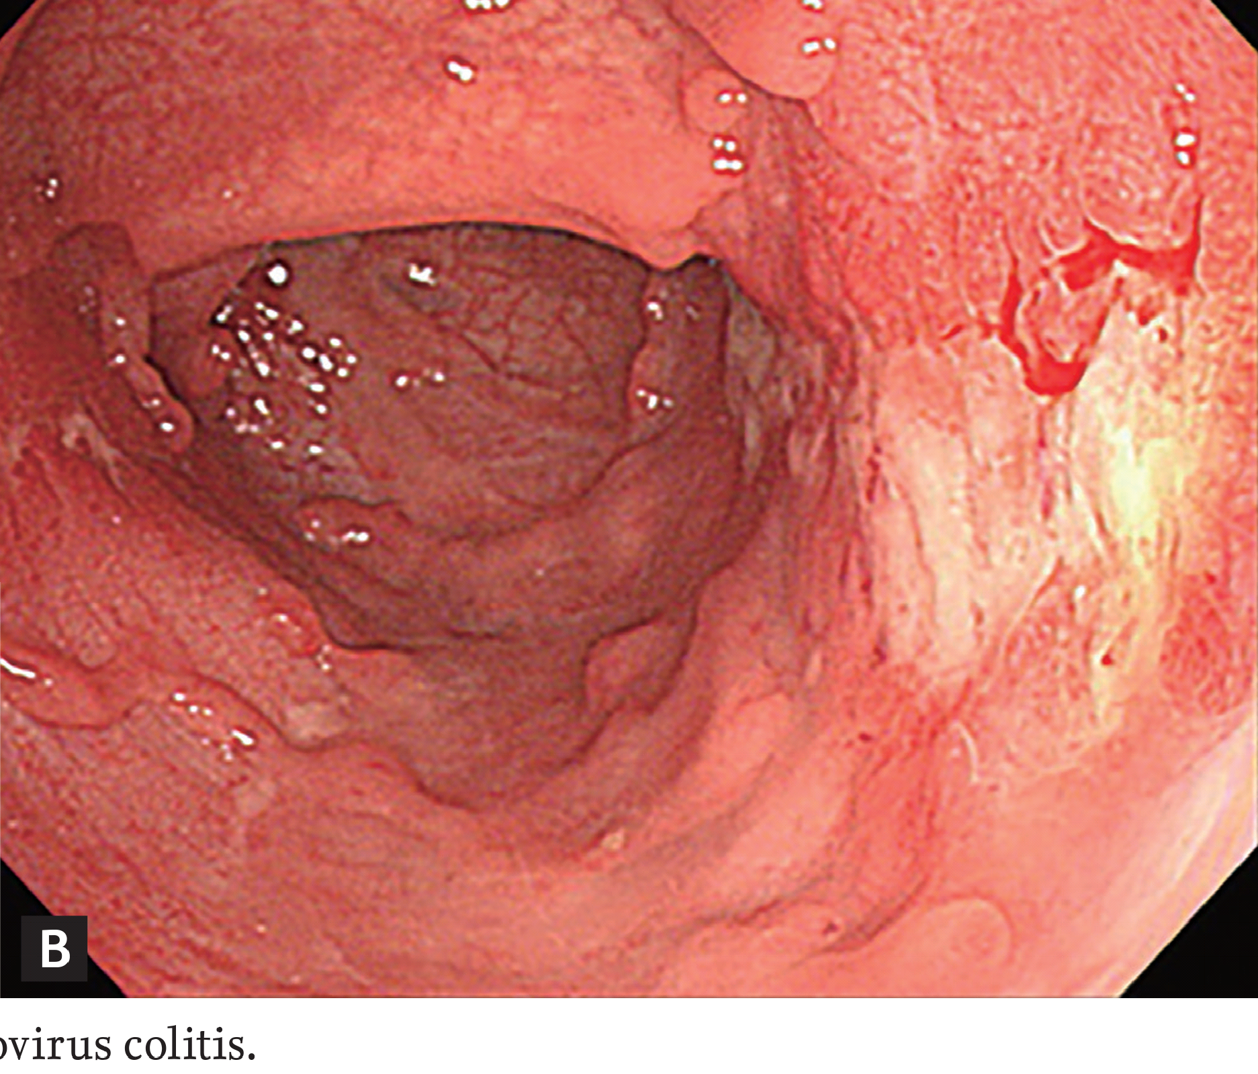

Slide 12
Irregular ulceration and wide mucosal defects were more common in patients with UC complicated by CMV infection than in those with UC alone.
However, CMV may be detected even if ulcers are absent; it is difficult to differentiate CMV colitis from acute exacerbation of severe UC based only on endoscopic findings .
Therefore, to ensure early diagnosis, CMV colitis should be suspected in all patients who do not improve on steroids or immunomodulatory therapy.

Slide 13
Diagnostic tests for CMV colitis
Diagnostic blood tests for CMV include serum antibody measurements, the CMV antigenemia assay, and PCR of CMV DNA.
A positive CMV IgG antibody test confirms past exposure to CMV and identifies patients at risk of CMV colitis; the test is highly sensitive and specific when used to detect latent infections. Although the CMV IgM antibody test is very sensitive and specific when employed to detect acute infection or CMV reactivation accompanied by viremia, the results do not correlate well with CMV colitis
However, antigenemia assay results may depend on disease severity and the doses of immunosuppressants (such as steroids) prescribed; no cut-off value for diagnosis of CMV colitis has yet been established.

Slide 14
PCR of serum CMV DNA may be diagnostic, but no cut-off value separating latent from active infection has yet been defined.
PCR of serum is more useful for detection of CMV viremia than is detection of anti-CMV antibodies;
In a recent study diagnosing suspected CMV colitis in patients with moderate-to-severe UC, serum DNA PCR-positivity was defined as > 250 copies/mL.
Sensitivities of the CMV antigenemia and serum CMV DNA PCR tests were relatively low (47.0% and 44.3%, respectively); however, the specificities were high (81.7% and 87.9%) .
Notably, both the CMV antigenemia and blood CMV DNA PCR tests were diagnostically useful in UC patients with endoscopically significant ulcers; the tests predicted CMV colitis with 67.3% sensitivity and 75.7% specificity in such patients.
Furthermore, CMV antigenemia-positivity was significantly associated with the need for subsequent colectomy in patients with UC and CMV colitis, suggesting

Slide 16
In moderate to severe UC, the CMV antigenemia assay exhibited relatively low sensitivity (66.7%) but high specificity (87.1%) when used to diagnose CMV colitis; antigenemia-positivity was significantly associated with refractoriness to corticosteroid therapy.
The optimal cut-off value was two pp65-positive cells, affording a sensitivity of 66.7% and a specificity of 90.3%. These findings suggest that although the low sensitivity of the CMV antigenemia assay renders it difficult to replace endoscopic biopsy with the assay when it is sought to diagnose CMV colitis in patients with UC, the high diagnostic specificity might aid in early diagnosis of CMV colitis in severely ill patients who require prompt treatment prior to time-consuming IHC staining.
as CMV infection is associated with poor responses to steroids and infliximab, use of the CMV antigenemia assay prior to the administration of such drugs in the acute exacerbation phase of UC might usefully predict the drug response. Early rescue therapy might be appropriate for UC patients who are positive on the CMV antigenemia assay.

Slide 17
Active CMV colitis is usually diagnosed by endoscopic CMV detection in colonic tissue, histological tests including H&E and IHC staining, and/or tissue PCR. H&E staining reveals the classical “owl’s eye” feature; the nuclei of cytomegalic cells containing CMV inclusion bodies are surrounded by clear cytoplasm. This diagnostic method affords high specificity (92% to 100%), but low and variable sensitivity (10% to 87%); a combination of H&E and IHC staining increases the sensitivity to 78% to 93% .
PCR of CMV DNA in colonic tissue exhibits high sensitivity (92% to 96.7%) and specificity (93% to 98.7%) when used to diagnose CMV infection . Therefore, PCR of a colonic mucosal specimen may be helpful in IHC-negative cases of suspected CMV infection.
However, the clinical significance of a positive PCR result is unclear in the absence of histological signs of CMV colitis; the presence of CMV DNA alone does not distinguish a latent from an active infection.

Slide 18
In terms of the adequate specimen number, one study recommended that 11 sigmoidoscopic biopsies be taken for UC diagnosis, and 16 colonoscopic biopsies for CD diagnosis .
Therefore, tissue for histological examinations should be endoscopically collected at the ulcer base and edge for diagnosis of CMV colitis; the location and number of biopsies are more important than the choice of diagnostic method (IHC vs. PCR).
Despite the relatively high sensitivity (45% to 75%) and specificity (89% to 100%) of culture when it is sought to identify viruses, this method is of low clinical utility; no results are available for 2 to 4 weeks .
The American College of Gastroenterology guideline suggests that CMV superinfection may progress to severe colitis, refractory to maximal immunosuppressive therapy, and that diagnosis requires histological analysis employing sigmoidoscopy and viral culture .

Slide 19
The European Crohn’s and Colitis Organization guideline recommends the use of antiviral therapy for acute steroid-resistant colitis when CMV is detected in colonic tissue via PCR or IHC .
The Korean Association for the Study of Intestinal Diseases recommends antiviral therapy for severe UC when the patient is nonresponsive to 1 to 2 weeks of IV steroid therapy and positive for CMV by endoscopy and biopsy

Slide 20
TREATMENT OF CMV COLITIS IN UC PATIENTS
Indications for antiviral therapy :
Antiviral treatment did not greatly influence the long-term outcomes of patients with IBD and active CMV colitis. However, in UC patients who were notably steroid-dependent or -refractory, those received antiviral treatment experienced a significantly higher clinical remission rate (77.8%) at 12 months than did those who did not receive such treatment.
A recent meta-analysis found that antiviral agents did not reduce the colectomy risk in unselected UC patients with CMV
However, it is very likely that CMV is ‘an innocent bystander’ in patients with low CMV burdens but an active pathogen in those with high CMV burdens

Slide 21
CMV disease can be classified into high- and low-grade depending on the numbers of viral inclusions, suggesting that antiviral therapy should be prescribed for patients with high-grade disease, and should also be considered for those with low-grade CMV disease who are steroid-refractory or -dependent .
It was suggested that, in patients with active UC, who are CMV DNA-positive on the mucosal PCR assay, but who lack endoscopically evident large ulcers, a diagnosis of latent CMV infection is speculative and antiviral therapy is unnecessary
A recent study suggested that CMV should be treated when the viral load attained > 250 copies/mg of tissue;

Slide 22
Therefore, antiviral therapy may be indicated for cases of steroid-refractory/-dependent UC with high-grade CMV infection as indicated by several CMV inclusions evident on IHC, and for those with > 250 CMV DNA copies/mg of tissue or low-grade CMV infection (evidenced by few inclusions or 10 to 250 DNA copies/mg of tissue) with endoscopically large ulcers

Slide 23
Antiviral therapies
The remission rate of UC patients after antiviral therapy for CMV colitis is high (67% to 100%)
Ganciclovir is the treatment of choice;
The recommended dose is 5 to 7.5 mg/kg twice daily for 2 to 3 weeks. As the drug is renally excreted, both the dosage and frequency should be adjusted in patients with renal dysfunction.
Ganciclovir might induce severe complications, including:
myelosuppression,
neutropenia,
thrombocytopenia,
headache,
nausea, vomiting,
flare,
hypotension.
Blood cell numbers must be monitored regularly in patients on ganciclovir.

Slide 24
Foscarnet may serve as a secondary treatment for patients who are intolerant of, or resistant to, ganciclovir. Foscarnet is administered intravenously (90 mg/kg) twice daily for 2 to 3 weeks; the principal side-effect is nephrotoxicity
In clinical trial, blood PCR after cessation of antiviral therapy more accurately predicted the efficacy of such therapy than did viral culture or clinical assessment

Slide 25
Immunomodulators in the treatment of CMV colitis
The continued use of immunomodulators, including corticosteroids, thiopurines, and biologics, during antiviral therapy for CMV remains controversial.
The European guideline recommends that cessation of all immunomodulatory therapies, including steroids, should be considered until the CMV colitis symptoms are controlled, and that no immunomodulator should be prescribed for patients with systemic CMV disease .
Ciccocioppo suggested that steroids should be quickly tapered and discontinued, but immunosuppressants and biological agents with long-lasting effects should be maintained in patients with viral colitis (mucosal viral load ≥ 103/105 cells) and those exhibiting reactivation of latent infection

Slide 26
Sager et al. proposed that conventional corticosteroid therapy should be combined with antiviral therapy, and medical rescue therapy using immunosuppressants should be prescribed when necessary.
However, it may be that anti-TNF therapy is safe in CMV colitis patients and dose not exacerbate the disease.
Lavagna et al found that 42 of 60 patients (70%) with refractory CD were CMV-seropositive; however, no patient was positive on blood CMV PCR performed during three sessions of infliximab therapy, suggesting that infliximab did not reactivate CMV.
In a recent study, flare-ups in UC patients on maintenance therapy with azathioprine, or anti-TNF therapies such as infliximab and adalimumab, were evaluated. The proportions of patients exhibiting CMV reactivation at flare-up did not differ between the anti-TNF (35%) and the azathioprine group (38%), and the CMV DNA load did not become elevated during anti-TNF therapy.

Slide 27
Furthermore, when the infliximab doses were increased from 5 to 10 mg/kg after flare-ups in patients on anti-TNF therapy, the clinical responses did not differ in terms of CMV reactivation .
Anti-TNF agents inhibit CMV reactivation and reduce the incidence of CMV colitis by lowering TNF-α levels in colon tissue. Therefore, anti-TNF therapy may be preferable to other immunosuppressant therapies used to treat CMV reactivation-associated flare-ups in UC patients.
Several studies have shown that ganciclovir is essential for patients with steroid-refractory or -dependent UC and histologically high-grade CMV infections. Concomitant anti-TNF therapy to treat the UC may also be appropriate

Slide 28
CONCLUSIONS
CMV screening is required only for a subset of patients with UC CMV colitis can be diagnosed by histological IHC staining and tissue PCR; blood tests such as the CMV antigenemia assay may aid in early diagnosis and predict the clinical course.
Prescription of antiviral therapy may be based on the colon viral load. However, when such assessment is practically difficult, an endoscopically large ulcer may indicate that therapy is required.
Anti-TNF therapy as a step-up therapy may be considered to treat CMV reactivation-associated flare-ups in UC patients, in combination with antiviral treatment.

